Slide 1
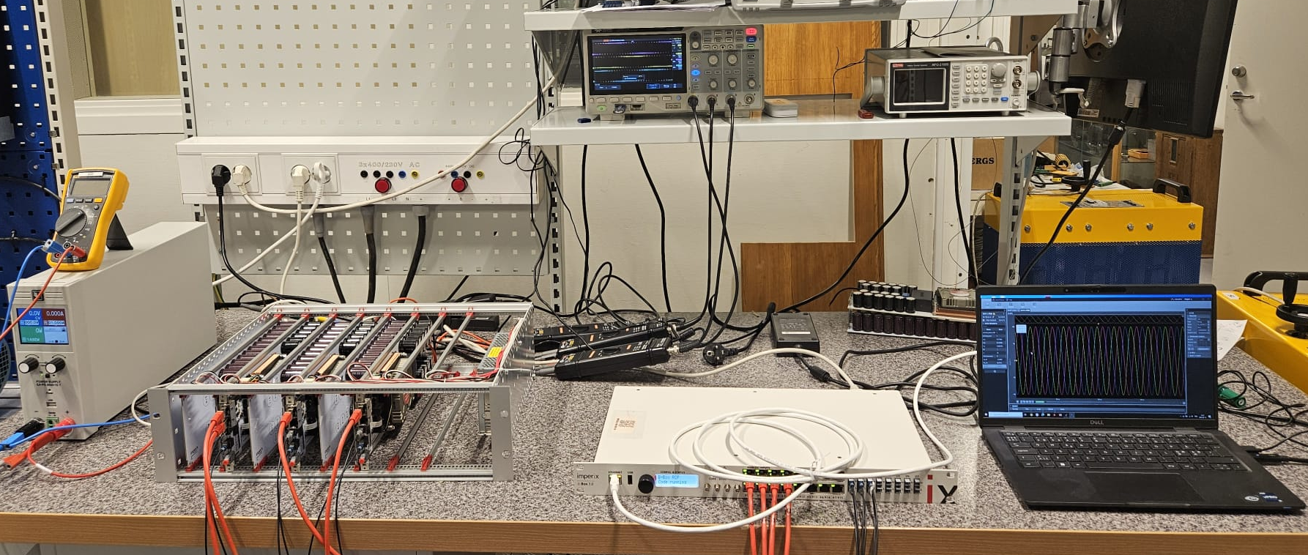
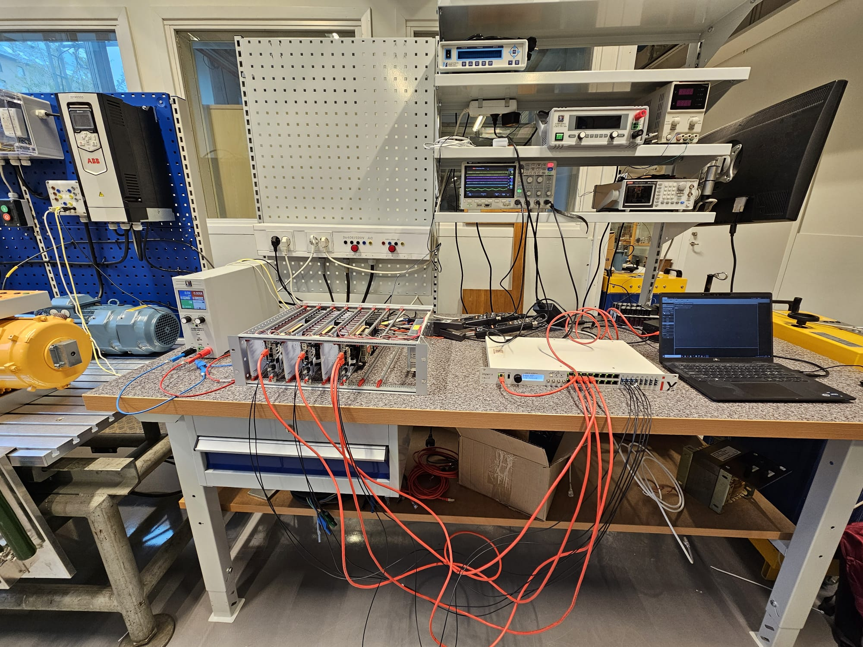
Induction Machines
Power Supply
2L-3Ph Inverter
Oscilloscope
Voltage Probes
PC
Controller

Slide 2
Power Supply
2L-3Ph Inverter
Oscilloscope
Induction Machine
Current Probe
Voltage Probes
PC
Controller

